Slide 1
Algorithm Analysis
Problem Solving with Algorithms & Data Structures Using Python

Slide 2
Objectives
To understand why algorithm analysis is important
To be able to use Big O to describe execution time
To understand the Big O execution time of common operations on Python lists and dictionaries
To understand how the implementation of Python data impacts algorithm analysis
To understand how to benchmark simple Python programs

Slide 3
What Is Algorithm Analysis?

Slide 4
What Is Algorithm Analysis?
Comparing algorithms based on the amount of computing resources they use
Space
Time
Benchmark analysis

Slide 5
Big O Notation
Most algorithms depend on the size of a problem
As problem gets larger, program runs longer
Dependency is not always linear
Some operations take the same time regardless of the problem size
Big O notation (order of magnitude) provides a useful approximation of the actual number of steps in the computation
O(f(n))
Data-specific algorithms
Best-case
Worst-case
Average-case

Slide 6
Common Functions for Big O
Constant
Logarithmic
Linear
Log linear
Quadratic
Cubic
Exponential

Slide 7
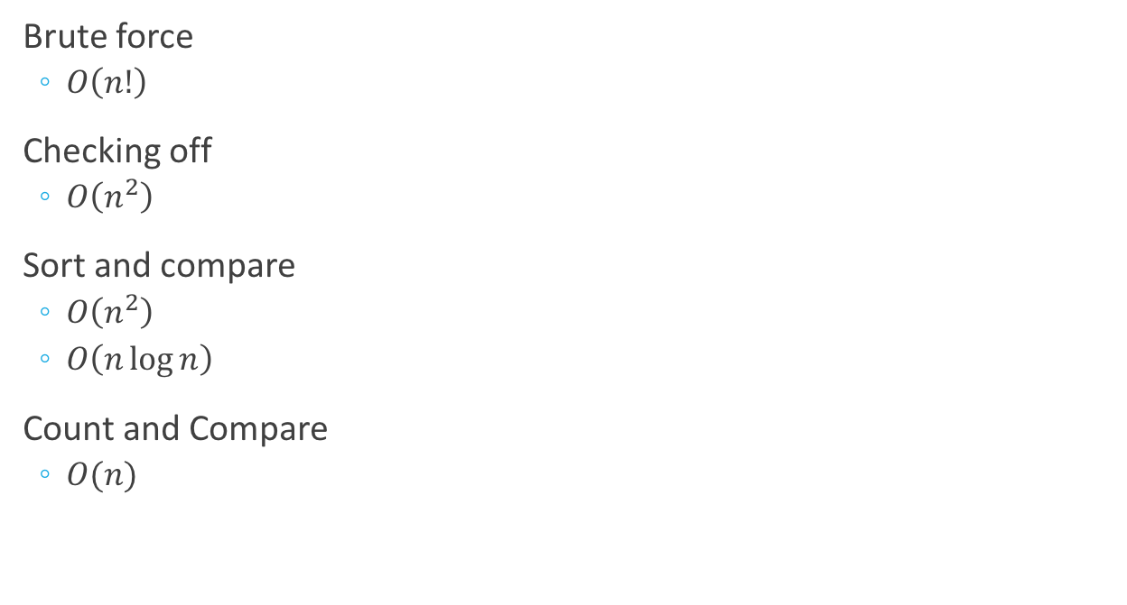
Anagram Detection
Brute force
$O\left(n!\right)$
Checking off
$O\left(n^{2}\right)$
Sort and compare
$O\left(n^{2}\right)$
$O\left(n\log{n}\right)$
Count and Compare
$O(n)$

Slide 8
Performance of Python Data Structures

Slide 9
List
Operation | Big O Efficiency
index [] | O(1)
append | O(1)
pop() | O(1)
pop(i) | O(n)
insert(i, item) | O(n)
contains (in) | O(n)
reverse | O(n)
sort | O(n log n)

Slide 10
Dictionary
Operation | Big O Efficiency
copy | O(n)
get item | O(1)
set item | O(1)
delete item | O(1)
contains (in) | O(1)
iteration | O(n)

Slide 11
Summary
Algorithm analysis is an implementation-independent way of measuring an algorithm
Big O notation allows algorithms to be classified by their dominant process with respect to the size of the problem

